Slide 1

그래픽(2D)
Gi Sook Jung, Ph.D
School of Computer Science and Engineering
College of IT Engineering, KNU

Slide 2
Graphics
2D Computer Graphics
  2차원 출력 장치에 표현된 컴퓨터에 의해 그려진 그림, 도형, 무늬
  Raster Graphics: 화소(픽셀)로 이루어진 그래픽
  수많은 색상 점들이 모자이크처럼 이미지를 구성
  Vector Graphics: 선과 면으로 이루어진 그래픽
  출력되기 전 래스터로 변환되어 출력되며 확대/축소에도 변화가 적음
구성 요소
  Pixel
  Vector(Path)
  Bitmap
  Text

Slide 3
Example #10_4
Canvas

Slide 4
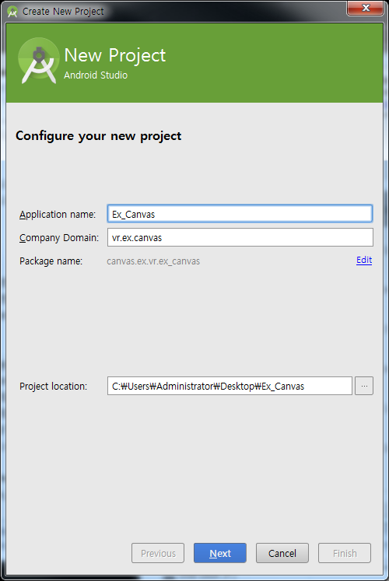
New Project
새로운 프로젝트 시작
  Android Project
  Application name: Ex_Canvas
  Build Target: Android 6.0
  Package name: vr.ex.canvas
  Create Activity: Act1

Slide 5
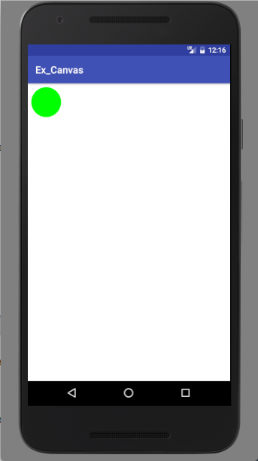
Canvas
Ex_Canvas
/src/Act1.java
public class Act1 extends Activity {
/** Called when the activity is first created. */
@Override
public void onCreate(Bundle savedInstanceState) {
super.onCreate(savedInstanceState);
setContentView(new CanvasView(this));
}
protected class CanvasView extends View {
public CanvasView(Context context) {
super(context);
}
public void onDraw(Canvas canvas) {
canvas.drawColor(Color.WHITE);
Paint paint = new Paint();
paint.setColor(Color.GREEN);
canvas.drawCircle(100, 100, 80, paint);
}
}
}

Slide 6
Canvas
Canvas class
  직접적인 그리기 객체
  drawPoint, drawLine, drawCircle, drawRect, drawText
  drawARGB, drawColor, drawPaint, drawRoundRect, drawOval, drawArc
  drawLines, drawPoints
  http://developer.android.com/reference/android/graphics/Canvas.html
Paint class
  색상이나 글꼴, 채우기 스타일 등의 그리기 정보들을 정의한 객체
  setColor, setARGB, setAntiAlias
  setStrokeWidth, setStrokeCap, setStrokeJoin, setStrokeMiter
  setStyle
  http://developer.android.com/reference/android/graphics/Paint.html

Slide 7
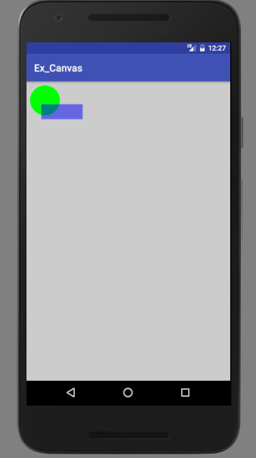
Canvas
Ex_Canvas
/src/Act1.java
public void onDraw(Canvas canvas) {
canvas.drawColor(Color.LTGRAY);
Paint paint = new Paint();
paint.setColor(Color.GREEN);
canvas.drawCircle(100, 100, 80, paint);
paint.setARGB(127,0,0,255);
canvas.drawRect(80, 120, 300, 200, paint);
}

Slide 8
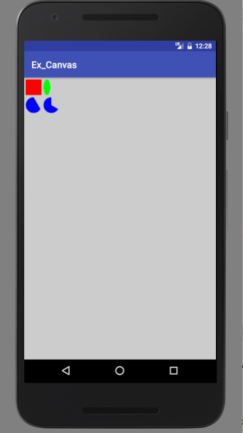
Canvas
Ex_Canvas
/src/Act1.java
public void onDraw(Canvas canvas) {
canvas.drawColor(Color.LTGRAY);
Paint paint = new Paint();
paint.setColor(Color.RED);
RectF rect = new RectF(10, 10, 100, 100);
canvas.drawRoundRect(rect, 5, 5, paint);
paint.setColor(Color.GREEN);
rect.set(110, 10, 150, 100);
canvas.drawOval(rect, paint);
paint.setColor(Color.BLUE);
rect.set(10, 110, 100, 200);
canvas.drawArc(rect, 30, 240, false, paint);
rect.set(110, 110, 200, 200);
canvas.drawArc(rect, 30, 240, true, paint);
}

Slide 9
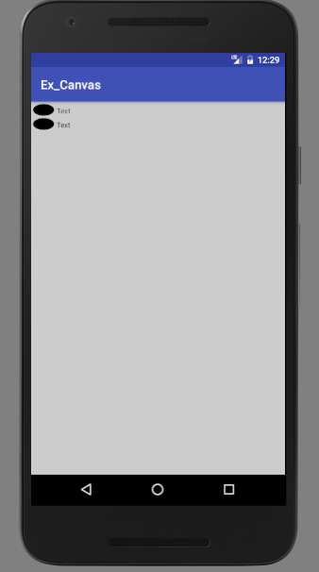
Canvas
Ex_Canvas
/src/Act1.java
public void onDraw(Canvas canvas) {
canvas.drawColor(Color.LTGRAY);
Paint paint = new Paint();
paint.setColor(Color.BLACK);
paint.setTextSize(30);
paint.setAntiAlias(false);
RectF rect = new RectF(10, 10, 100, 60);
canvas.drawOval(rect, paint);
canvas.drawText("Text", 110, 50, paint);
paint.setAntiAlias(true);
rect.offset(0, 60);
canvas.drawOval(rect, paint);
canvas.drawText("Text", 110, 110, paint);
}

Slide 10
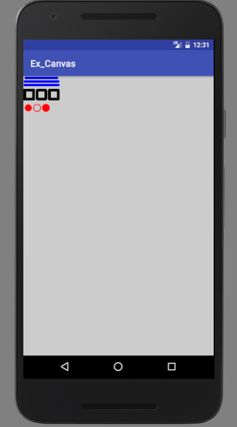
Canvas
Ex_Canvas
/src/Act1.java
public void onDraw(Canvas canvas) {
canvas.drawColor(Color.LTGRAY);
Paint paint = new Paint(Paint.ANTI_ALIAS_FLAG);
paint.setColor(Color.BLUE);
paint.setStrokeWidth(14);
canvas.drawLine(10,10,200,10, paint);
paint.setStrokeCap(Paint.Cap.ROUND);
canvas.drawLine(10,30,200,30, paint);
paint.setStrokeCap(Paint.Cap.SQUARE);
canvas.drawLine(10,50,200,50, paint);
paint.setColor(Color.BLACK);
paint.setStrokeWidth(16);
paint.setStyle(Paint.Style.STROKE);
paint.setStrokeJoin(Paint.Join.MITER);
canvas.drawRect(10,80,60,130, paint);
paint.setStrokeJoin(Paint.Join.BEVEL);
canvas.drawRect(80,80,130,130, paint);
paint.setStrokeJoin(Paint.Join.ROUND);
canvas.drawRect(150,80,200,130, paint);

Slide 11
Canvas
Ex_Canvas
/src/Act1.java
paint.setStrokeWidth(5);
paint.setColor(Color.RED);
paint.setStyle(Paint.Style.FILL);
canvas.drawCircle(30,180,20, paint);
paint.setStyle(Paint.Style.STROKE);
canvas.drawCircle(80,180,20,paint);
paint.setStyle(Paint.Style.FILL_AND_STROKE);
canvas.drawCircle(130,180,20,paint);
}

Slide 12
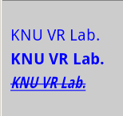
Text
Ex_Canvas
/src/Act1.java
public void onDraw(Canvas canvas) {
canvas.drawColor(Color.LTGRAY);
Paint paint = new Paint(Paint.ANTI_ALIAS_FLAG);
String msg = "KNU VR Lab.";
paint.setColor(Color.BLUE);
paint.setTextSize(20);
canvas.drawText(msg, 10, 50, paint);
paint.setTypeface(Typeface.create((String)null, Typeface.BOLD));
canvas.drawText(msg, 10, 80, paint);
paint.setUnderlineText(true);
paint.setStrikeThruText(true);
paint.setSubpixelText(true);
paint.setTextSkewX(-0.24f);
paint.setTextScaleX(0.8f);
canvas.drawText(msg, 10, 110, paint);
}

Slide 13
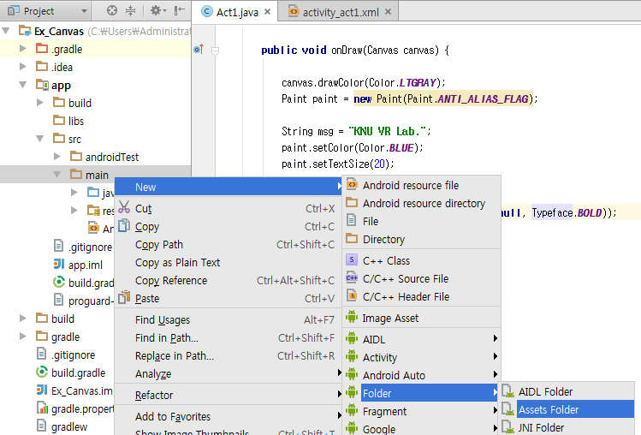
Text
글꼴 파일을 추가
  Bitbucket에서 graphic2D.zip(http://www.fontsquirrel.com/fonts/3Dumb, 한글안됨)
  Project: app/src/main/ 아래에 asset 폴더 생성

Slide 14
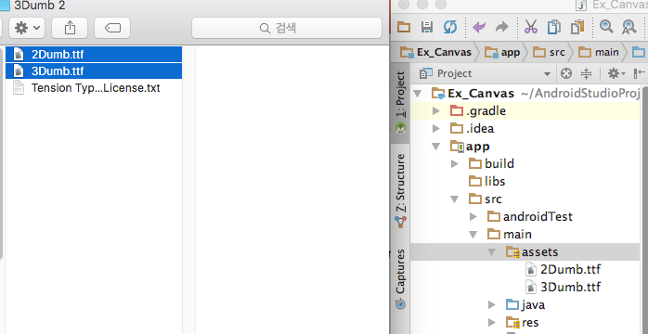
Text
글꼴 파일을 추가
  글꼴 폴더에서 assets 폴더로 Drag & Drop

Slide 15
Text
Ex_Canvas
/src/Act1.java
public class Act1 extends Activity {
/** Called when the activity is first created. */
Typeface mFont;
@Override
public void onCreate(Bundle savedInstanceState) {
super.onCreate(savedInstanceState);
setContentView(new CanvasView(this));
mFont = Typeface.createFromAsset( getAssets(), “3Dumb.ttf"); //대소문자구별함
}
…
}

Slide 16
Text
Ex_Canvas
/src/Act1.java
public void onDraw(Canvas canvas) {
canvas.drawColor(Color.LTGRAY);
Paint paint = new Paint(Paint.ANTI_ALIAS_FLAG);
String msg = "KNU VR Lab.";
paint.setColor(Color.BLUE);
paint.setTextSize(20);
canvas.drawText(msg, 10, 50, paint);
paint.setTypeface(Typeface.create((String)null, Typeface.BOLD));
canvas.drawText(msg, 10, 80, paint);
paint.setUnderlineText(true);
paint.setStrikeThruText(true);
paint.setSubpixelText(true);
paint.setTextSkewX(-0.24f);
paint.setTextScaleX(0.8f);
canvas.drawText(msg, 10, 110, paint);
paint.reset();
paint.setAntiAlias(true);
paint.setTypeface(mFont);
paint.setTextSize(50);
canvas.drawText(msg, 10, 170, paint);
}

Slide 17
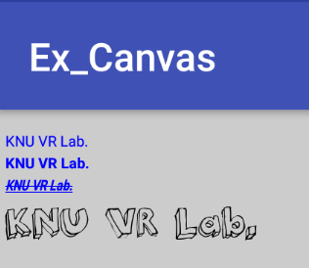
Text

Slide 18
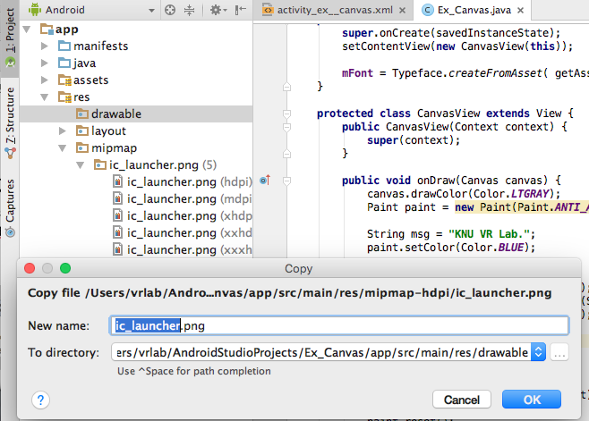
Bitmap
이미지 파일을 추가
  /res/drawable/android.png
  Bitbucket ~ downloads android.png in graphic2D.zip

Slide 19
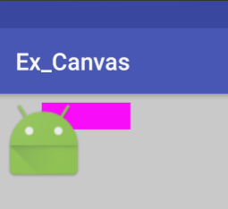
Bitmap
Ex_Canvas
/src/Act1.java
public void onDraw(Canvas canvas) {
canvas.drawColor(Color.LTGRAY);
Paint paint = new Paint(Paint.ANTI_ALIAS_FLAG);
paint.setColor(Color.MAGENTA);
canvas.drawRect(new Rect(100, 20, 300, 80), paint);
Resources res = getResources();
BitmapDrawable draw = (BitmapDrawable)res.getDrawable(R.drawable.ic_launcher);
Bitmap bmp = draw.getBitmap();
canvas.drawBitmap(bmp, null, new Rect(10,10, 200,200), null);
}

Slide 20
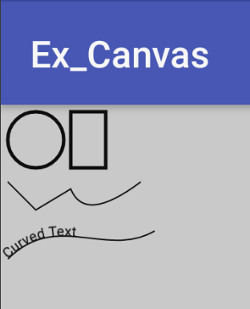
Path
Ex_Canvas
/src/Act1.java
public void onDraw(Canvas canvas) {
canvas.drawColor(Color.LTGRAY);
Paint paint = new Paint(Paint.ANTI_ALIAS_FLAG);
paint.setStrokeWidth(5);
paint.setStyle(Paint.Style.STROKE);
Path path = new Path();
path.addRect(100,10,150,90, Path.Direction.CW);
path.addCircle(50,50,40, Path.Direction.CW);
canvas.drawPath(path, paint);
paint.setStrokeWidth(2);
path.reset();
path.moveTo(10,110);
path.lineTo(50, 150);
path.rLineTo(50, -30);
path.quadTo(120,170,200,110);
canvas.drawPath(path, paint);
상대좌표 사용
Quadratic curve defined by,
- current point
- control point (x1, y1)
- end point (x2, y2)

Slide 21
Path
Ex_Canvas
/src/Act1.java
path.reset();
path.moveTo(10,220);
path.cubicTo(80,150, 150,220, 220,180);
canvas.drawPath(path, paint);
paint.setTextSize(20);
paint.setStyle(Paint.Style.FILL);
canvas.drawTextOnPath("Curved Text", path, 0, 0, paint);
}
Cubic curve defined by,
current point
1st control point (x1, y1)
1st control point (x2, y2)
end point (x3, y3)

Slide 22
Shader
Ex_Canvas
/src/Act1.java
public void onDraw(Canvas canvas) {
canvas.drawColor(Color.LTGRAY);
Paint paint = new Paint(Paint.ANTI_ALIAS_FLAG);
paint.setShader( new LinearGradient(0,0, 100,0,
Color.BLUE, Color.WHITE, Shader.TileMode.CLAMP) );
canvas.drawRect(0,0, 100,100, paint);
paint.setShader( new LinearGradient(110,0, 210,100,
Color.BLUE, Color.WHITE, Shader.TileMode.CLAMP) );
canvas.drawRect(110,0, 210,100, paint);

Slide 23
Shader
Ex_Canvas
/src/Act1.java
paint.setShader( new LinearGradient(220,100, 320,0,
Color.BLUE, Color.WHITE, Shader.TileMode.CLAMP) );
canvas.drawRect(220,0, 320,100, paint);
paint.setShader( new LinearGradient(0,0, 100,0,
Color.BLUE, Color.WHITE, Shader.TileMode.CLAMP) );
canvas.drawRect(0,110, 320,150, paint);
paint.setShader( new LinearGradient(0,0, 100,0,
Color.BLUE, Color.WHITE, Shader.TileMode.REPEAT) );
canvas.drawRect(0,160, 320,200, paint);
paint.setShader( new LinearGradient(0,0, 100,0,
Color.BLUE, Color.WHITE, Shader.TileMode.MIRROR) );
canvas.drawRect(0,210, 320,250, paint);

Slide 24
Shader
Ex_Canvas
/src/Act1.java
int[] color_list =
{ Color.RED, Color.GREEN, Color.BLUE,
Color.YELLOW, Color.WHITE };
float[] pos_list =
{ 0.0f, 0.1f, 0.6f, 0.9f, 1.0f };
paint.setShader( new LinearGradient(0,0, 320,0,
color_list, null, Shader.TileMode.CLAMP) );
canvas.drawRect(0,260, 320,300, paint);
paint.setShader( new LinearGradient(0,0, 320,0,
color_list, pos_list, Shader.TileMode.CLAMP) );
canvas.drawRect(0,310, 320,350, paint);
}
}

Slide 25
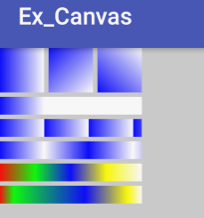
Shader

Slide 26
Shader
Ex_Canvas
/src/Act1.java
protected class CanvasView extends View {
public CanvasView(Context context) {
super(context);
}
public void onDraw(Canvas canvas) {
canvas.drawColor(Color.LTGRAY);
Paint paint = new Paint(Paint.ANTI_ALIAS_FLAG);
paint.setShader( new RadialGradient(80,80, 70,
Color.BLUE, Color.WHITE, Shader.TileMode.CLAMP) );
canvas.drawCircle(80,80, 70, paint);
paint.setShader( new RadialGradient(230,80, 70,
Color.BLUE, Color.WHITE, Shader.TileMode.CLAMP) );
canvas.drawCircle(230,80, 70, paint);

Slide 27
Shader
Ex_Canvas
/src/Act1.java
int[] color_list =
{ Color.RED, Color.GREEN, Color.BLUE,
Color.YELLOW, Color.WHITE };
float[] pos_list =
{ 0.0f, 0.1f, 0.6f, 0.9f, 1.0f };
paint.setShader( new RadialGradient(80,230, 70,
color_list, null, Shader.TileMode.CLAMP) );
canvas.drawCircle(80,230, 70, paint);
paint.setShader( new RadialGradient(230,230, 70,
color_list, pos_list, Shader.TileMode.CLAMP) );
canvas.drawCircle(230,230, 70, paint);
}
}

Slide 28
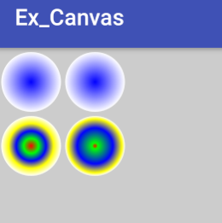
Shader

Slide 29
Shader
Ex_Canvas
/src/Act1.java
public void onDraw(Canvas canvas) {
canvas.drawColor(Color.LTGRAY);
Paint paint = new Paint(Paint.ANTI_ALIAS_FLAG);
paint.setShader( new SweepGradient(80,80, Color.BLUE, Color.WHITE) );
canvas.drawCircle(80,80, 70, paint);
paint.setShader( new SweepGradient(230,80, Color.BLUE, Color.WHITE) );
canvas.drawCircle(230,80, 70, paint);
int[] color_list =
{ Color.RED, Color.GREEN, Color.BLUE,
Color.YELLOW, Color.WHITE };
float[] pos_list =
{ 0.0f, 0.1f, 0.6f, 0.9f, 1.0f };
paint.setShader( new SweepGradient(80,230, color_list, null) );
canvas.drawCircle(80,230, 70, paint);
paint.setShader( new SweepGradient(230,230, color_list, pos_list) );
canvas.drawCircle(230,230, 70, paint);
}

Slide 30
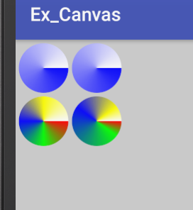
Shader

Slide 31


